Slide 1


LOAN DEFAULT PREDICTION
A Data-Driven Approach
By Sudarshan Wadajkar
Email : wadajkar0@gmail.com

Slide 2

Table of
CONTENTS
01
02
03
04
Data Overview
Data Exploration
Data Preprocessing
Feature Engineering
05
06
07
08
Model Selection
Model Training and Evaluation
Conclusion
References

Slide 3

DATA OVERVIEW
We have a bank loan dataset which consists of various features. Our task is, to create a model to predict whether the customer will default.

Slide 4
DATASET SNAPSHOT
 | Loan ID | Loan Status | Current Loan Amount | Term | Credit Score | Annual Income | Years in current job | Home Ownership | Purpose | Monthly Debt | Years of Credit History | Months since last delinquent | Number of Open Accounts | Number of Credit Problems | Current Credit Balance | Maximum Open Credit | Bankruptcies | Tax Liens
0 | L-18553-88177a-12bsdc-aa-1 | Fully Paid | 445412 | Short Term | 709.0 | 1167493.0 | 8 years | Home Mortgage | Home Improvements | 5214.74 | 17.2 | NaN | 6 | 1 | 228190 | 416746.0 | 1.0 | 0.0
1 | L-18553-88177a-12bsdc-aa-2 | Fully Paid | 262328 | Short Term | NaN | NaN | 10+ years | Home Mortgage | Debt Consolidation | 33295.98 | 21.1 | 8.0 | 35 | 0 | 229976 | 850784.0 | 0.0 | 0.0
2 | L-18553-88177a-12bsdc-aa-3 | Fully Paid | 99999999 | Short Term | 741.0 | 2231892.0 | 8 years | Own Home | Debt Consolidation | 29200.53 | 14.9 | 29.0 | 18 | 1 | 297996 | 750090.0 | 0.0 | 0.0
3 | L-18553-88177a-12bsdc-aa-4 | Fully Paid | 347666 | Long Term | 721.0 | 806949.0 | 3 years | Own Home | Debt Consolidation | 8741.90 | 12.0 | NaN | 9 | 0 | 256329 | 386958.0 | 0.0 | 0.0
4 | L-18553-88177a-12bsdc-aa-5 | Fully Paid | 176220 | Short Term | NaN | NaN | 5 years | Rent | Debt Considilation | 20639.70 | 6.1 | NaN | 15 | 0 | 253460 | 427174.0 | 0.0 | 0.0

Slide 5
Numerical Features
Categorical
Features
Current Loan Amount
Credit Score
Annual Income
Years in current job
Monthly Debt
Years of credit history
Current Credit Balance
Months since last delinquent
Number of Open Accounts
Number of Credit Problems
Maximum Open Credit
Bankruptcies
Tax Liens
Term
Home Ownership
Purpose
Loan Status

Slide 6
DEFINITIONS
Loan ID: Unique identifier for each loan application.
Loan Status: Indicates whether the loan is in default or not.
Current Loan Amount: Amount of the current loan.
Term: Duration of the loan (e.g., short-term, long-term).
Credit Score: Numerical representation of the borrower's creditworthiness.
Annual Income: Total income earned by the borrower annually.
Years in current job: Number of years the borrower has been in their current job.
Home Ownership: Type of home ownership (e.g., own home, rent, mortgage).
Purpose: Reason for taking out the loan.
Monthly Debt: Total monthly debt payments made by the borrower.
Years of Credit History: Number of years since the borrower's first credit account was opened.

Slide 7
DEFINITIONS
Months since last delinquent: Number of months since the borrower's last delinquency.
Number of Open Accounts: Total number of open credit accounts.
Number of Credit Problems: Total number of credit problems reported by the borrower.
Current Credit Balance: Total amount of outstanding debt owed by the borrower.
Maximum Open Credit: Maximum amount of credit extended to the borrower.
Bankruptcies: Number of bankruptcies reported by the borrower.
Tax Liens: Number of tax liens reported by the borrower.

Slide 8
SUMMARY STATISTICS
Numerical Features
 | Current Loan Amount | Credit Score | Annual Income | Monthly Debt | Years of Credit History | Months since last delinquent | Number of Open Accounts | Number of Credit Problems | Current Credit Balance | Maximum Open Credit | Bankruptcies | Tax Liens
Total Count | 1.000000e+05 | 80846.000000 | 8.084600e+04 | 100000.000000 | 100000.000000 | 46859.000000 | 100000.00000 | 100000.000000 | 1.000000e+05 | 9.999800e+04 | 99796.000000 | 99990.000000
Mean | 1.176045e+07 | 1076.456089 | 1.378277e+06 | 18472.412336 | 18.199141 | 34.901321 | 11.12853 | 0.168310 | 2.946374e+05 | 7.607984e+05 | 0.117740 | 0.029313
Median | 312246 | 722 | 1.174162e+06 | 16237.21 | 16.9 | 32 | 10 | 0 | 209817 | 467874 | 0 | 0
Minimum | 1.080200e+04 | 585.000000 | 7.662700e+04 | 0.000000 | 3.600000 | 0.000000 | 0.00000 | 0.000000 | 0.000000e+00 | 0.000000e+00 | 0.000000 | 0.000000
Maximum | 1.000000e+08 | 7510.000000 | 1.655574e+08 | 435843.280000 | 70.500000 | 176.000000 | 76.00000 | 15.000000 | 3.287897e+07 | 1.539738e+09 | 7.000000 | 15.000000
Standard Deviation | 3.178394e+07 | 1475.403791 | 1.081360e+06 | 12174.992609 | 7.015324 | 21.997829 | 5.00987 | 0.482705 | 3.761709e+05 | 8.384503e+06 | 0.351424 | 0.258182

Slide 9
SUMMARY STATISTICS
Summary Statistics- Categorical Features
 | Loan ID | Loan Status | Term | Years in current job | Home Ownership | Purpose
Total Count | 100000 | 100000 | 100000 | 95778 | 100000 | 100000
Unique Value Counts | 100000 | 2 | 2 | 11 | 4 | 16
Most Frequent | L-18553-88177a-12bsdc-aa-1 | Fully Paid | Short Term | 10+ years | Home Mortgage | Debt Consolidation
Frequency | 1 | 77361 | 72208 | 31121 | 48410 | 78552

Slide 10
DATA
EXPLORATION

Slide 11
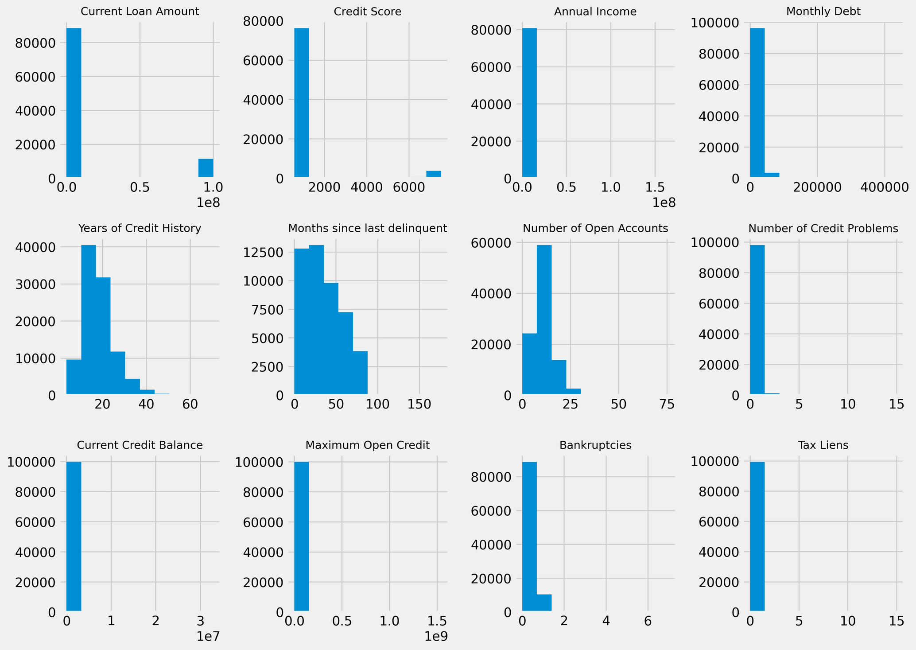
Histogram & Bar Plots

Slide 12
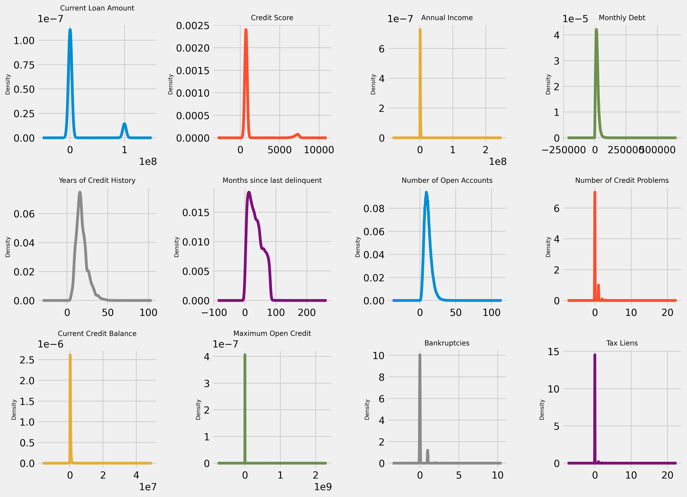
Density Plots

Slide 13
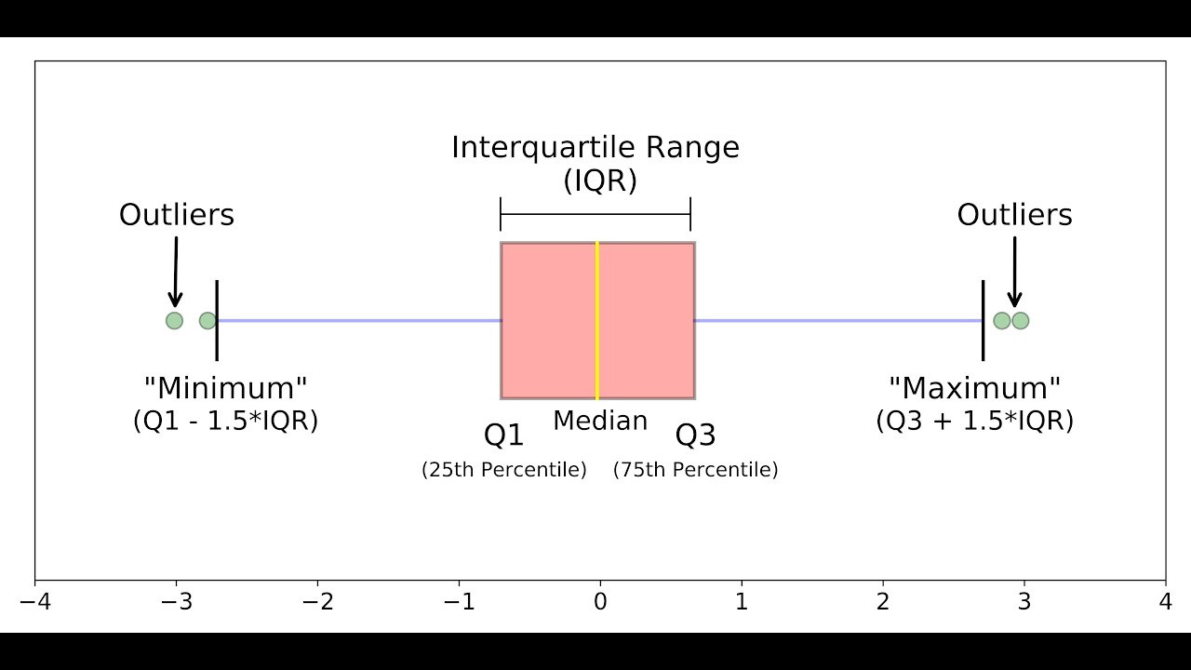
Refresher : How to read box plots?
The k-th percentile is a value below which k% of the data falls.
Q1, Q2 (Median), Q3, and Q4 refer to the quartiles of a dataset, which divide the data into four equal parts.

Slide 14
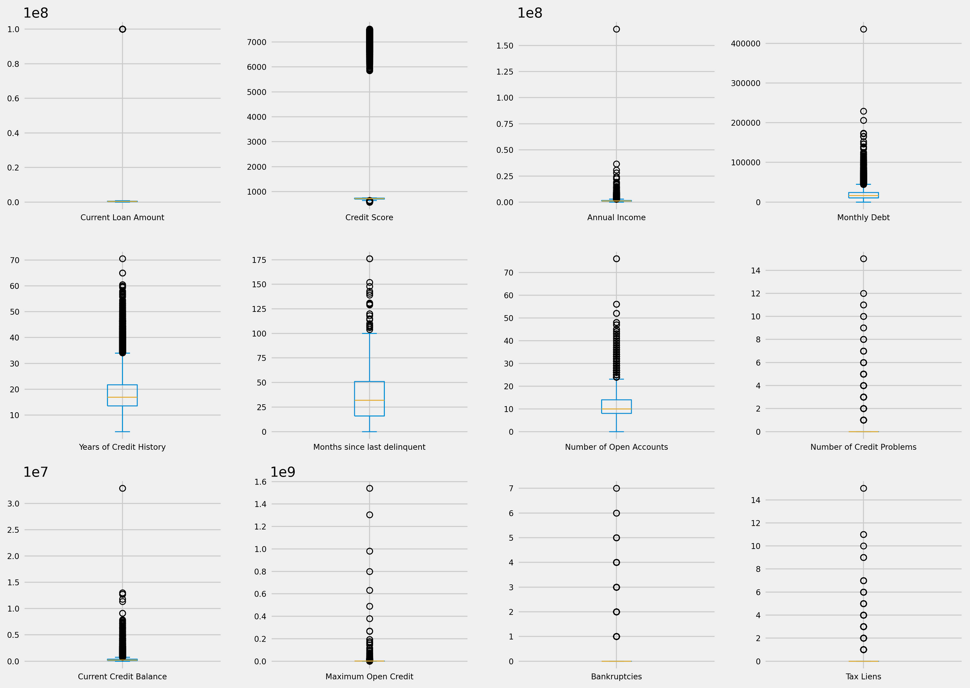
Box Plots
Outliers exist, so they could be taken care of

Slide 15
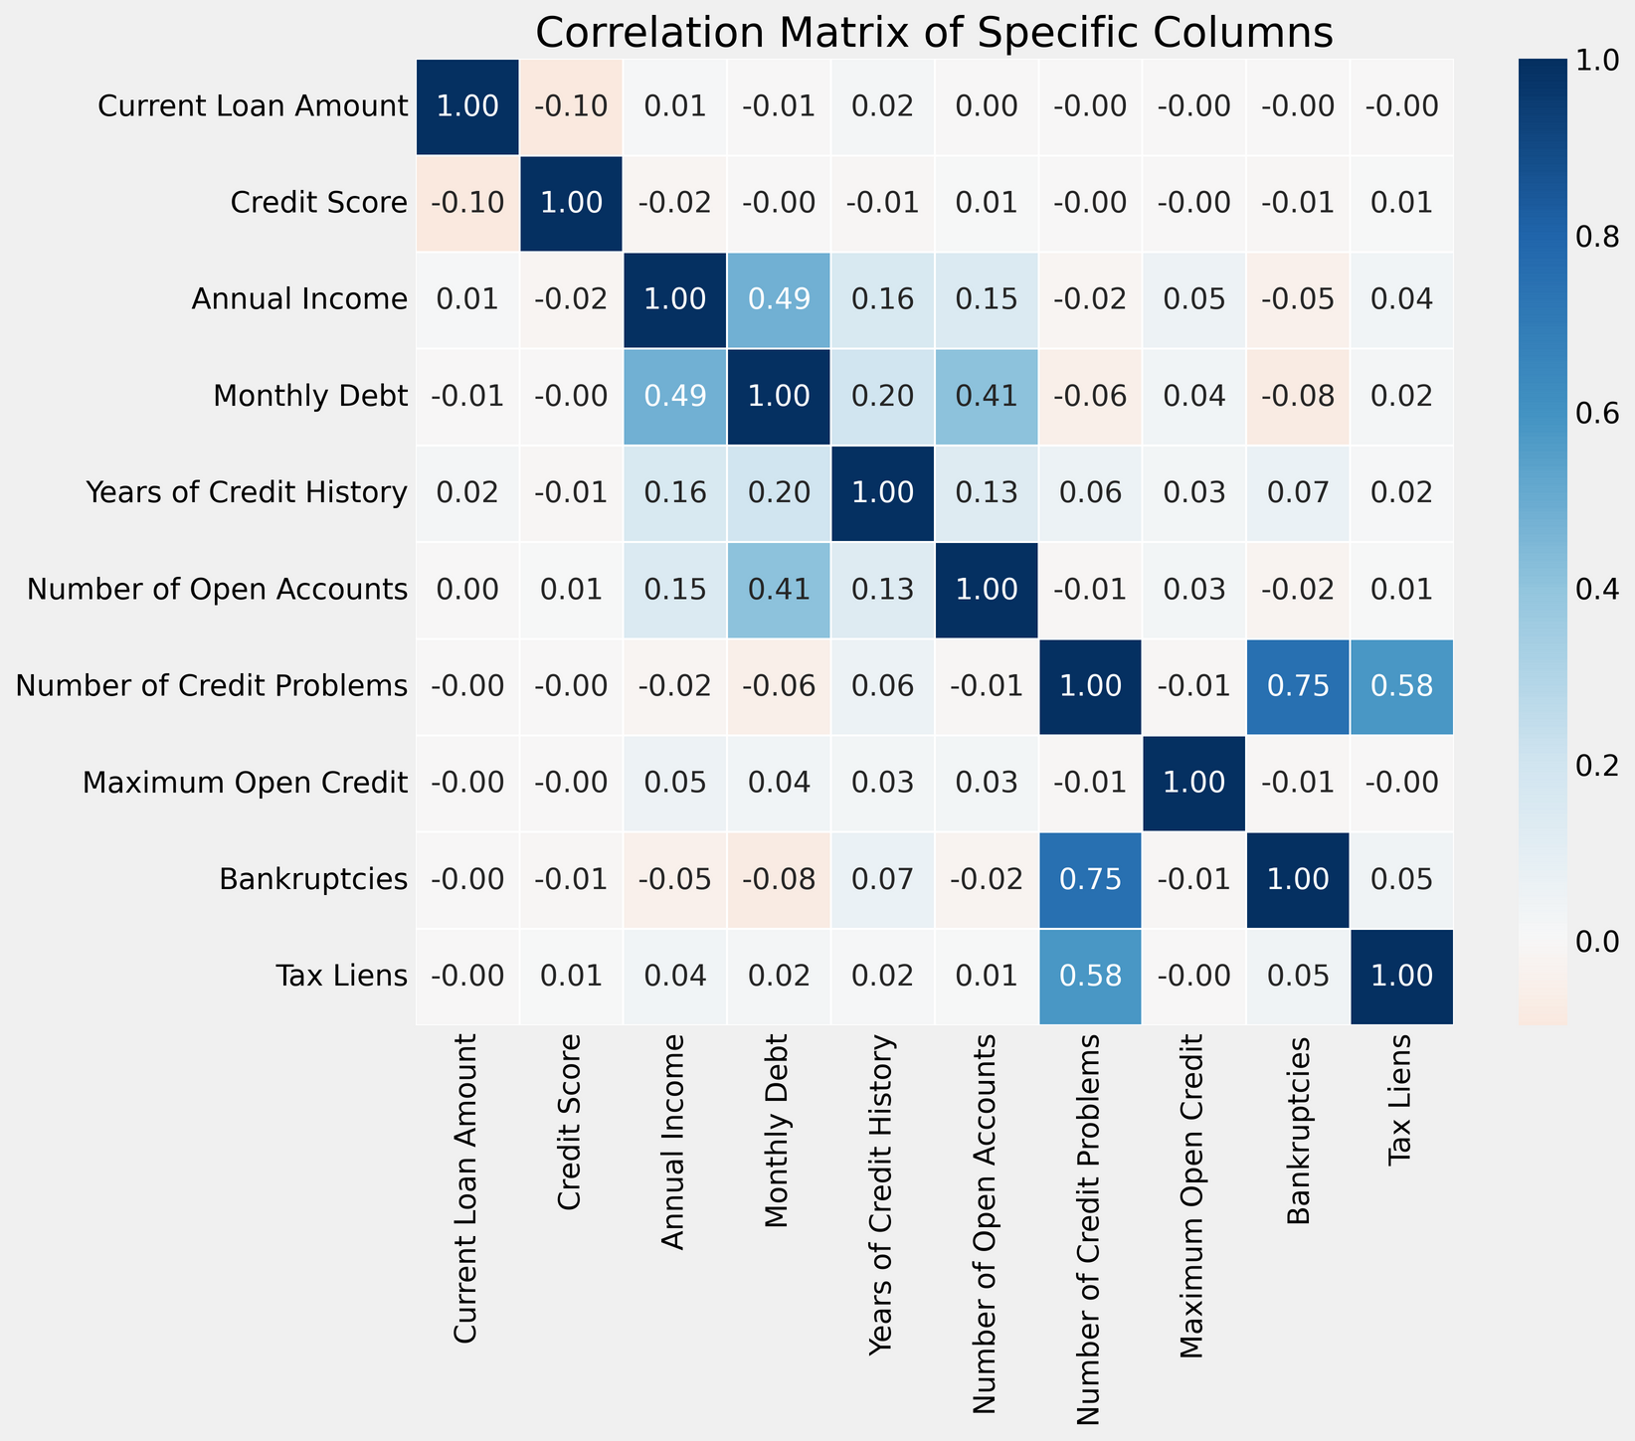
Correlation
The closer the correlation coefficient is to 1 or -1, the stronger the relationship between the variables. A value closer to 0 indicates a weaker relationship.
Number of credit problems is highly correlated with bankruptcies
These pairs are slightly correlated as well:
Monthly Debt and Annual Income
Monthly Debt and Number of Open Accounts
Tax Liens and Number of Credit Problems

Slide 16
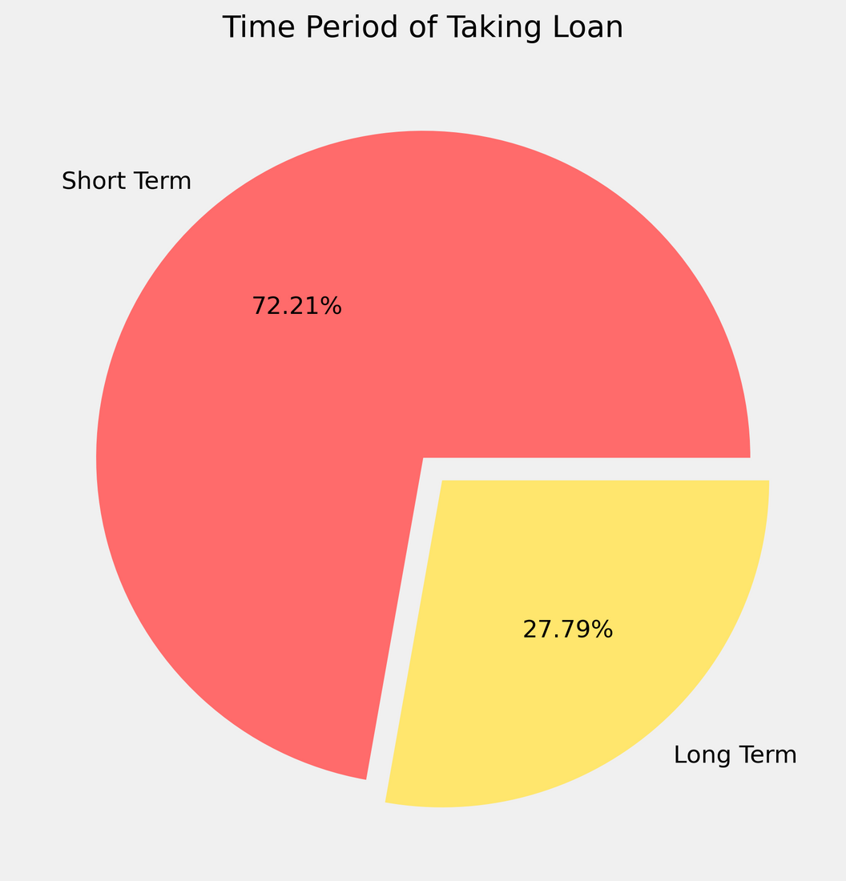
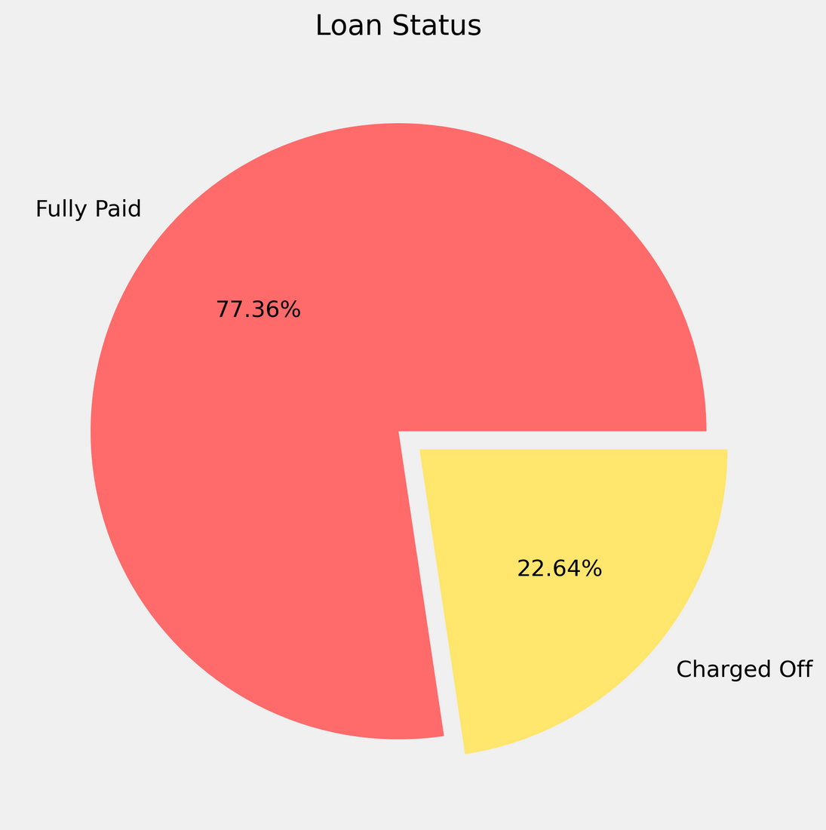
INSIGHTS
Short terms loans consititute the majority of loans
Around 23% of the total loans sanctioned were charged off

Slide 17
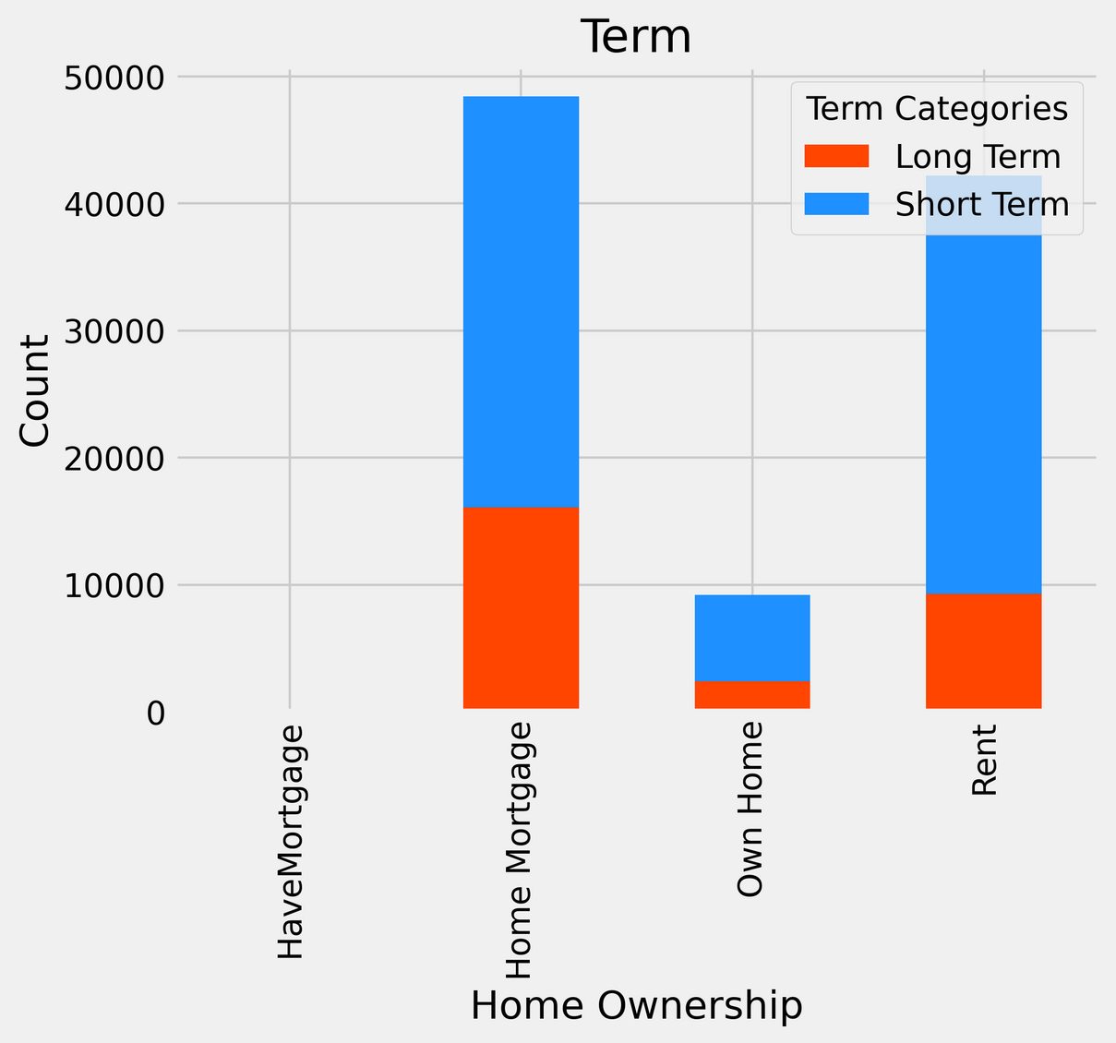
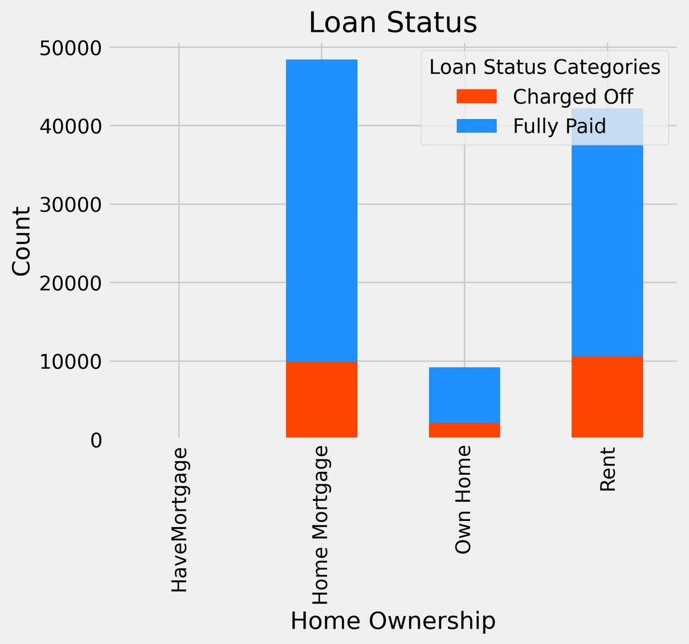
INSIGHTS
People having mortgage and rent take majority of loans
The proportion of charged off to fully paid is similar in all cases

Slide 18
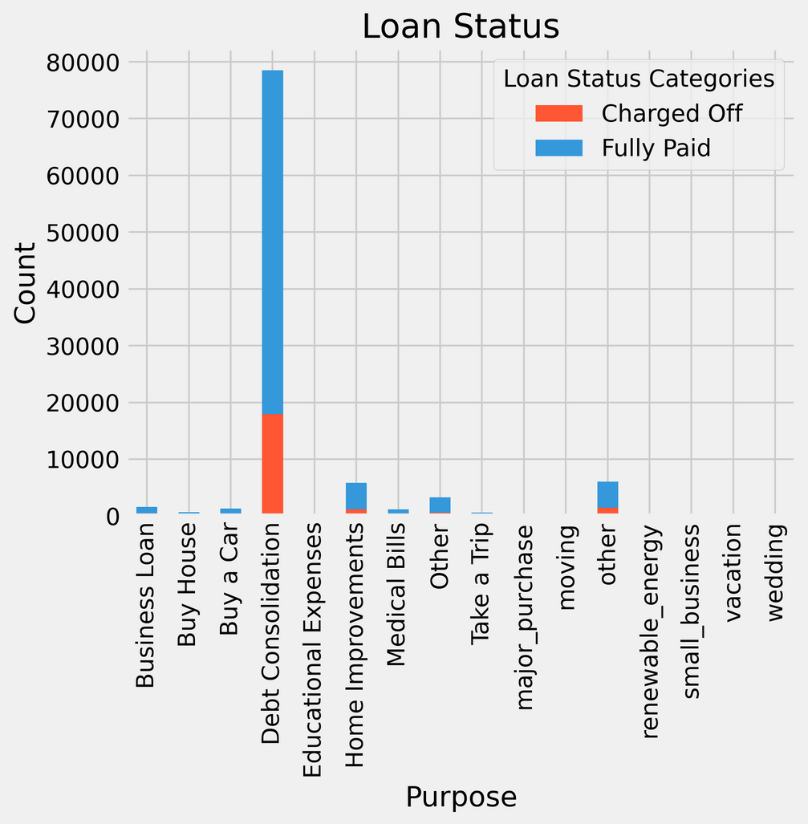
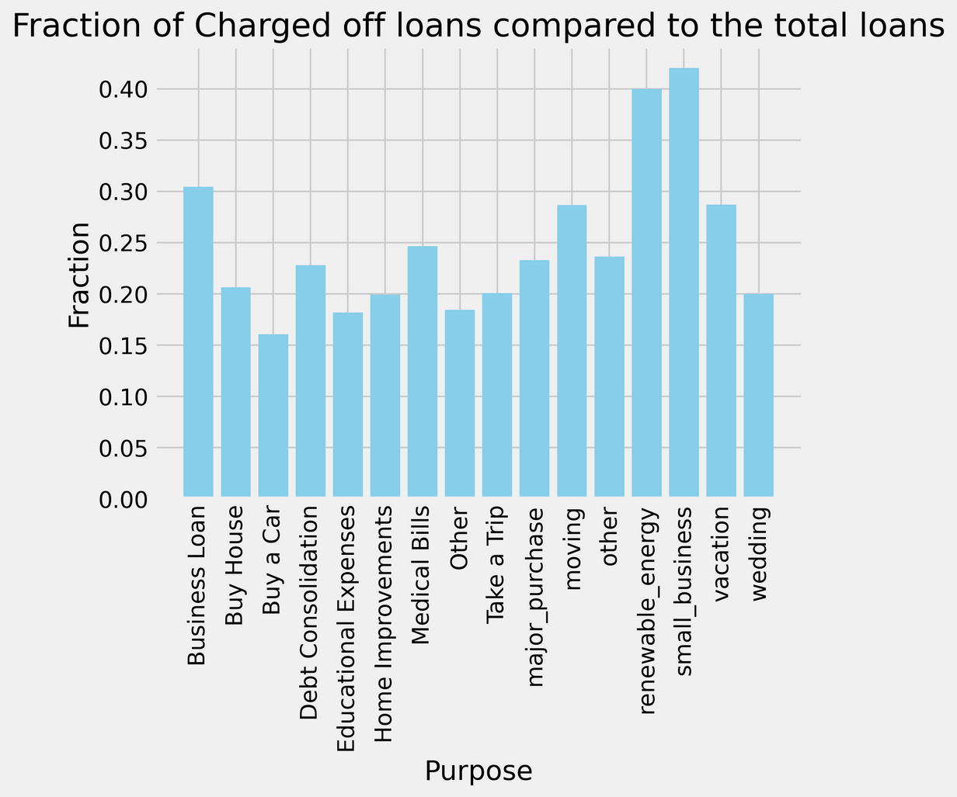
Debt Consolidation was the top reason for taking loans
Loans taken for renewable energy and business purposes were more likely to be charged off

Slide 19
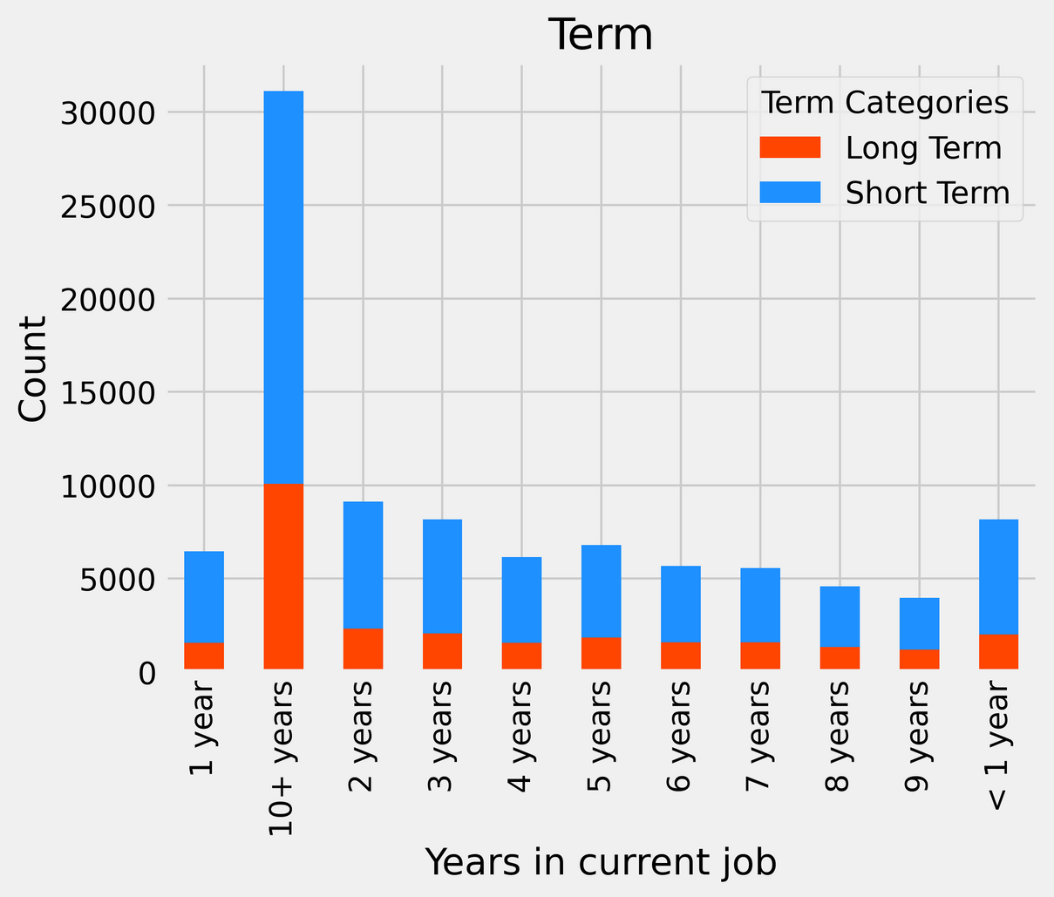
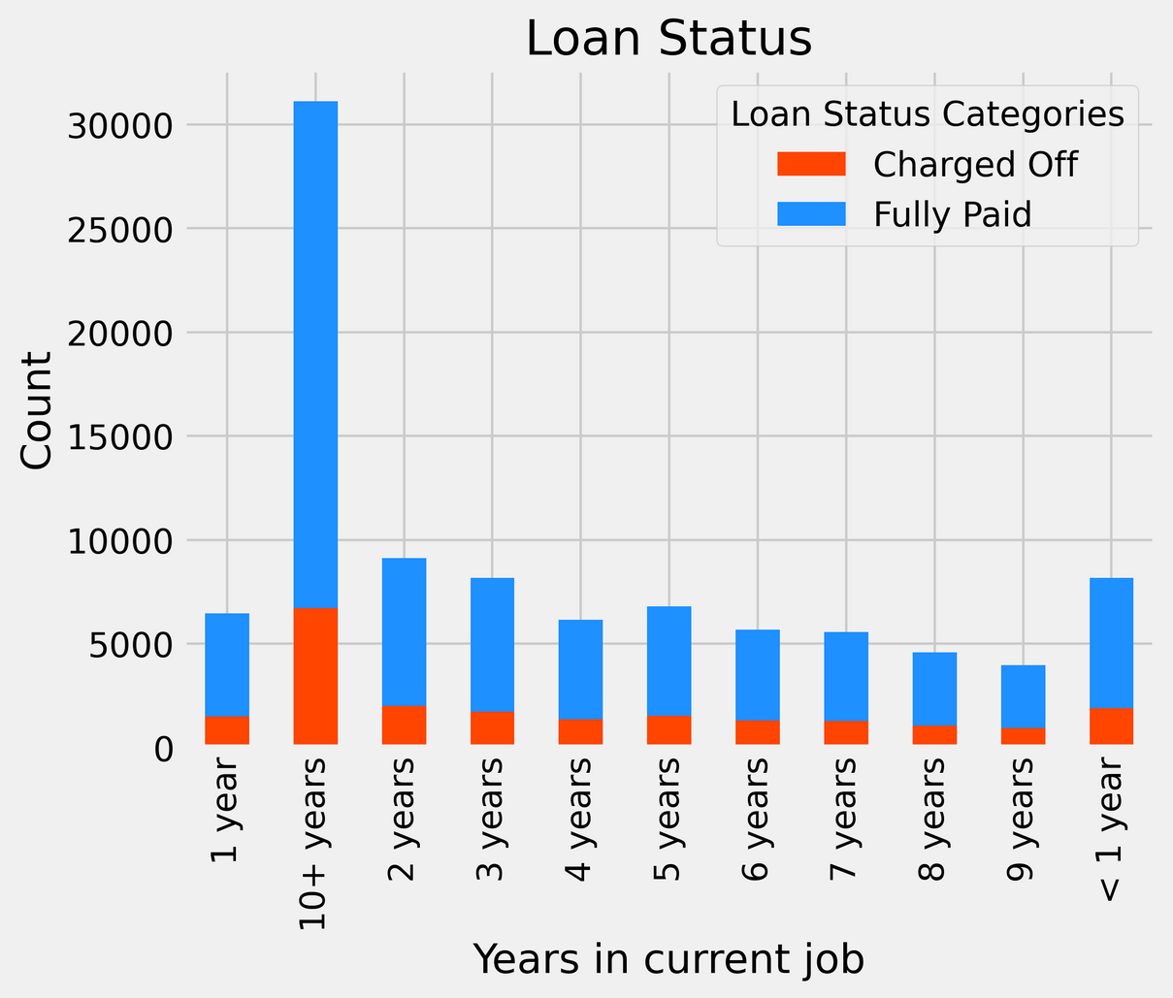
Majority of sanctioned loans are granted to/taken by customers with over 10 years of work experience
Interesting to note that years of experience have no relationship with share of loans charged off

Slide 20
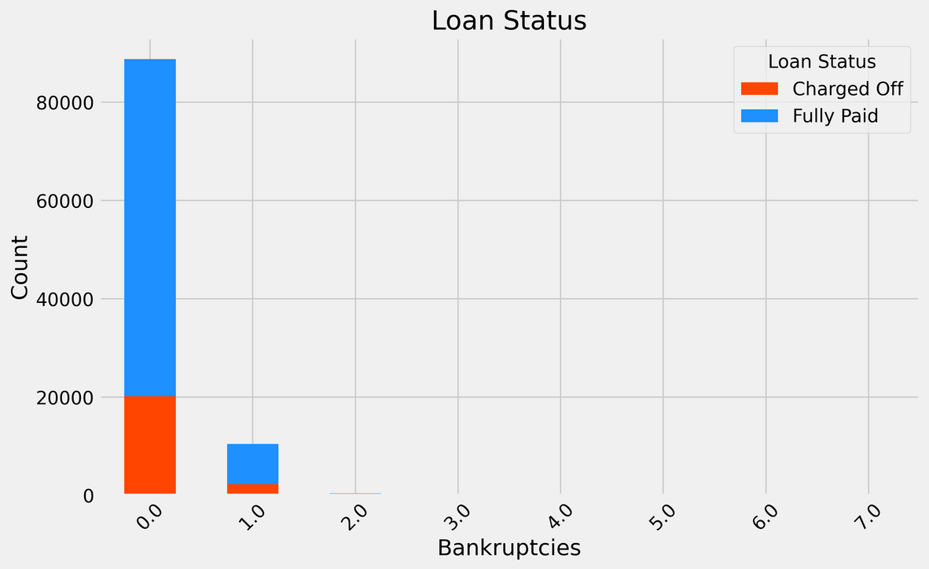
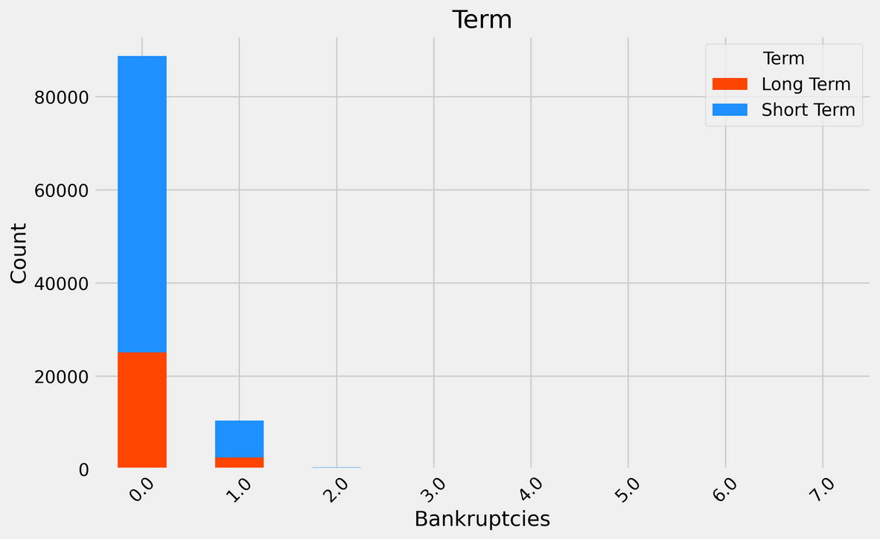
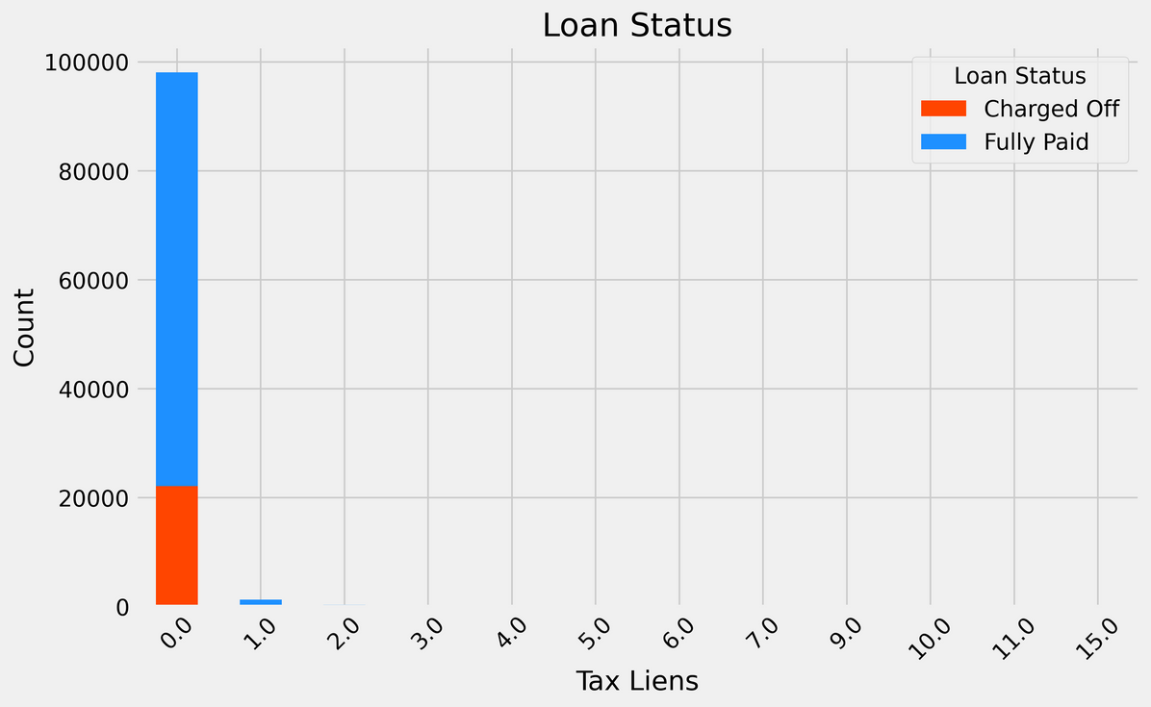
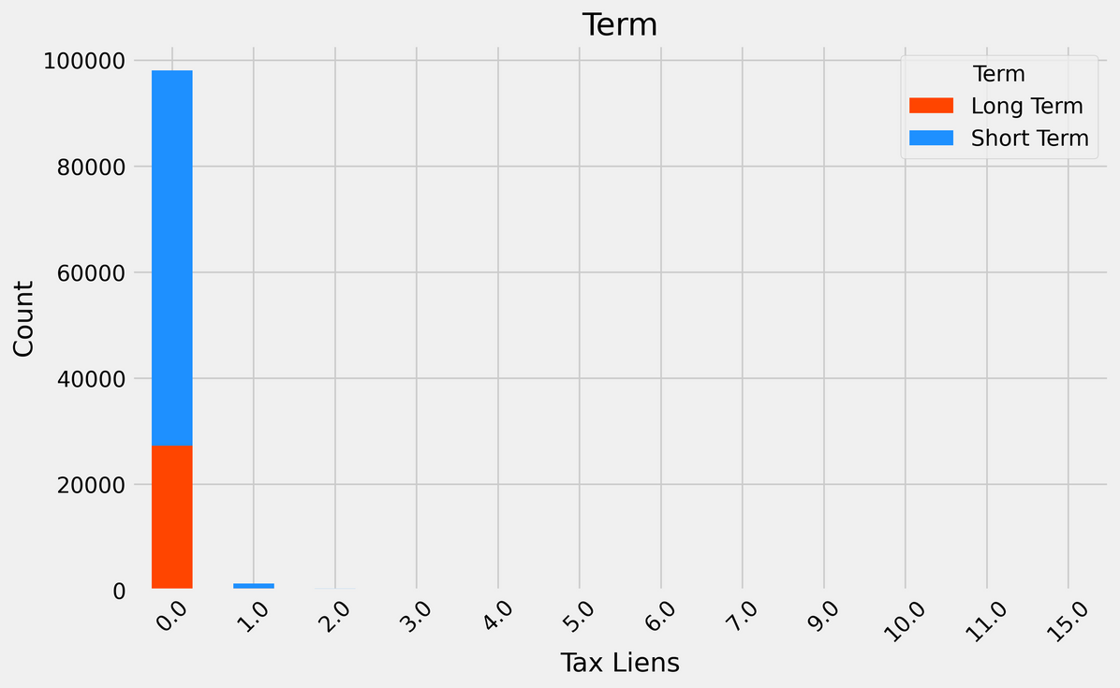
Majority of loan takers have no bankruptcies or tax liens against them

Slide 21
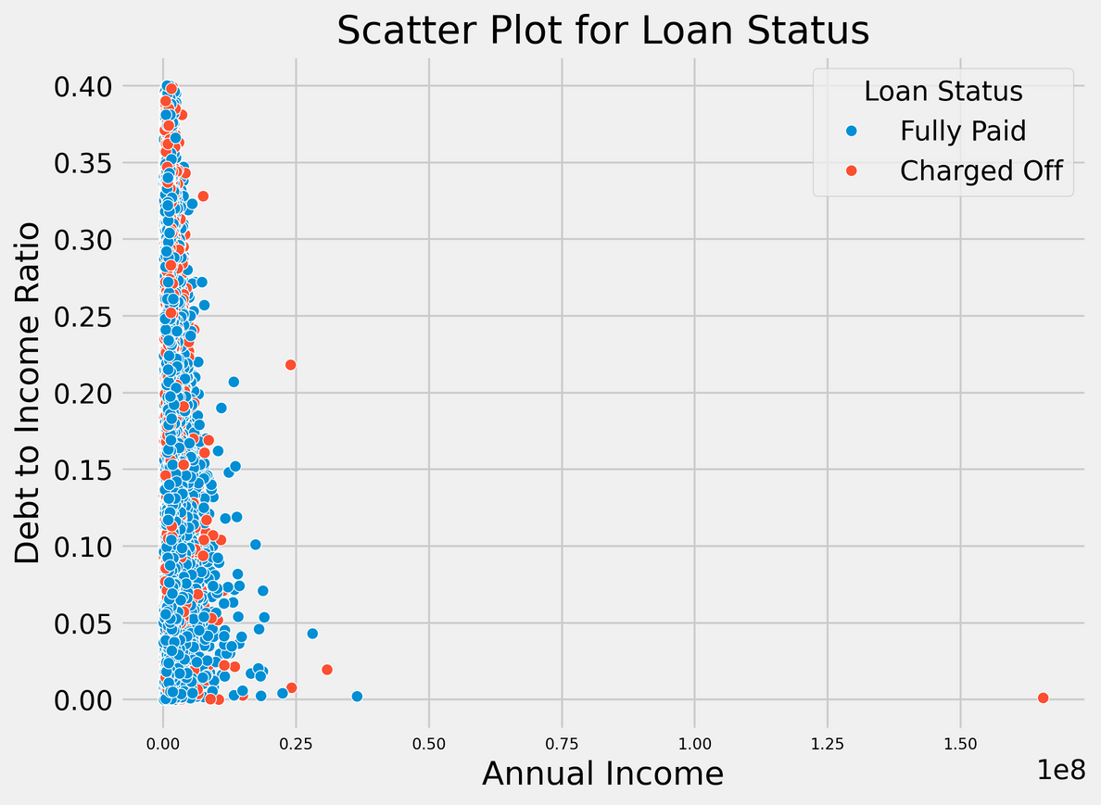
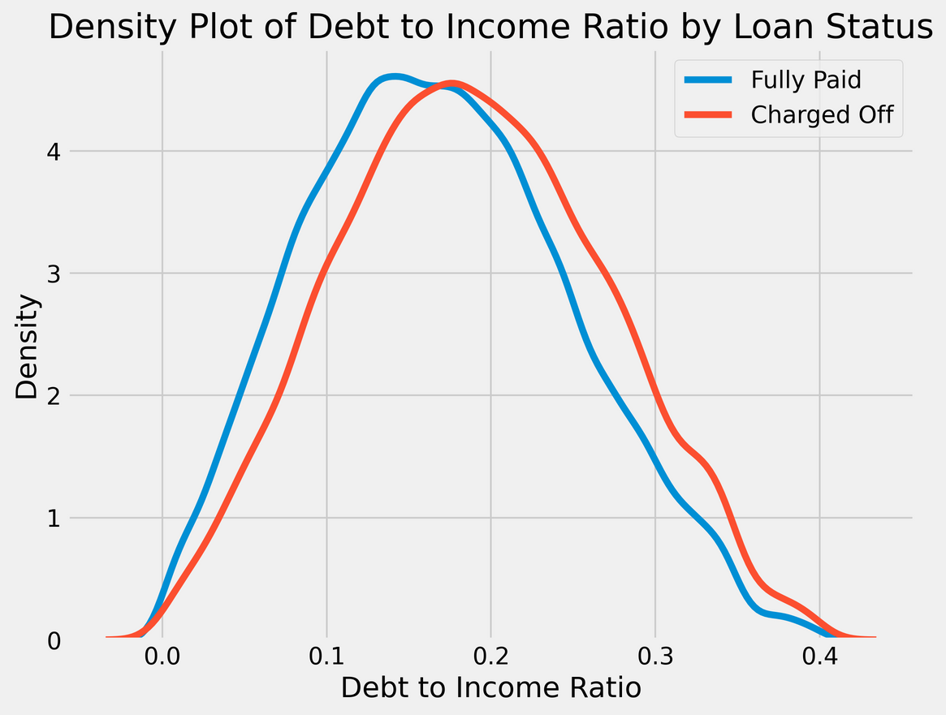
INSIGHTS
Here, we have considered annual debt to annual income ratio.
No, explicit relation between the ratio and annual income.
Customers with higher debt to income ratio are more likely to default.

Slide 22
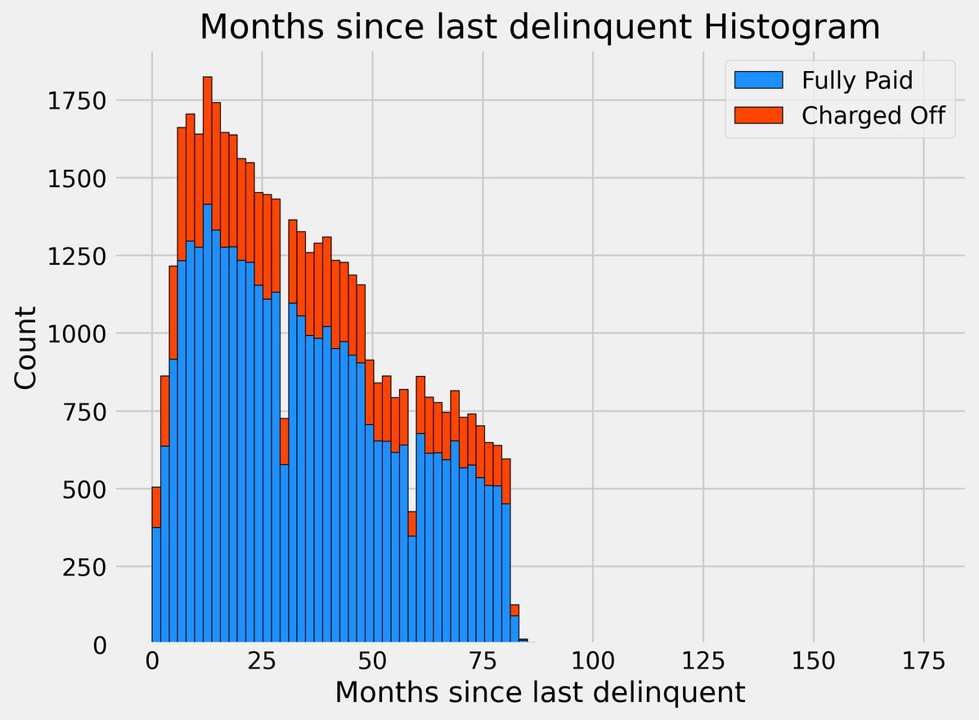
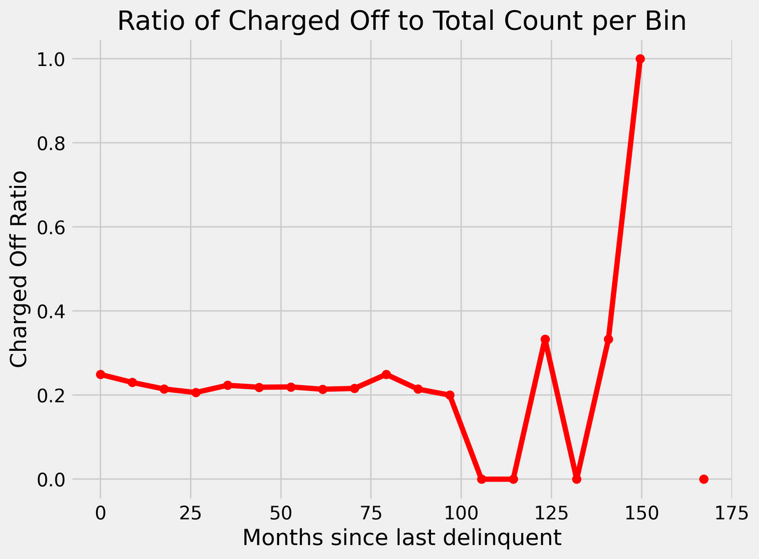
INSIGHTS
There is no obvious relationship between months since delinquency and ratio of total loans charged off per bin in the histogram.

Slide 23
DATA
PREPROCESSING

Slide 24
DATASET SNAPSHOT
Just to refresh, this is how our dataset looks like:
100000 rows, 18 columns
 | Loan ID | Loan Status | Current Loan Amount | Term | Credit Score | Annual Income | Years in current job | Home Ownership | Purpose | Monthly Debt | Years of Credit History | Months since last delinquent | Number of Open Accounts | Number of Credit Problems | Current Credit Balance | Maximum Open Credit | Bankruptcies | Tax Liens
0 | L-18553-88177a-12bsdc-aa-1 | Fully Paid | 445412 | Short Term | 709.0 | 1167493.0 | 8 years | Home Mortgage | Home Improvements | 5214.74 | 17.2 | NaN | 6 | 1 | 228190 | 416746.0 | 1.0 | 0.0
1 | L-18553-88177a-12bsdc-aa-2 | Fully Paid | 262328 | Short Term | NaN | NaN | 10+ years | Home Mortgage | Debt Consolidation | 33295.98 | 21.1 | 8.0 | 35 | 0 | 229976 | 850784.0 | 0.0 | 0.0
2 | L-18553-88177a-12bsdc-aa-3 | Fully Paid | 99999999 | Short Term | 741.0 | 2231892.0 | 8 years | Own Home | Debt Consolidation | 29200.53 | 14.9 | 29.0 | 18 | 1 | 297996 | 750090.0 | 0.0 | 0.0
3 | L-18553-88177a-12bsdc-aa-4 | Fully Paid | 347666 | Long Term | 721.0 | 806949.0 | 3 years | Own Home | Debt Consolidation | 8741.90 | 12.0 | NaN | 9 | 0 | 256329 | 386958.0 | 0.0 | 0.0

Slide 25
HANDLING MISSING VALUES
Columns | Count of Null Values | Null Values Handling
Loan ID | 0
Loan Status | 0
Current Loan Amount | 0
Term | 0
Credit Score | 19154 | FILL WITH MEDIAN VALUE
Annual Income | 19154 | FILL WITH MEDIAN VALUE
Years in current job | 4222 | FILL WITH MEDIAN VALUE
Home Ownership | 0
Purpose | 0
Monthly Debt | 0
Years of Credit History | 0

Slide 26
HANDLING MISSING VALUES
Columns | Count of Null Values | Null Values Handling
Months since last delinquent | 53141 | REMOVE COLUMN
Number of Open Accounts | 0
Number of Credit Problems | 0
Current Credit Balance | 0
Maximum Open Credit | 2 | FILL WITH MEDIAN VALUE
Bankruptcies | 204 | FILL WITH MEDIAN VALUE
Tax Liens | 10 | FILL WITH MEDIAN VALUE
Removed the ‘Months since last delinquent’ column since >50% values were missing
Changed years in current job from
After the changes given in the table, our data contains no null values

Slide 27
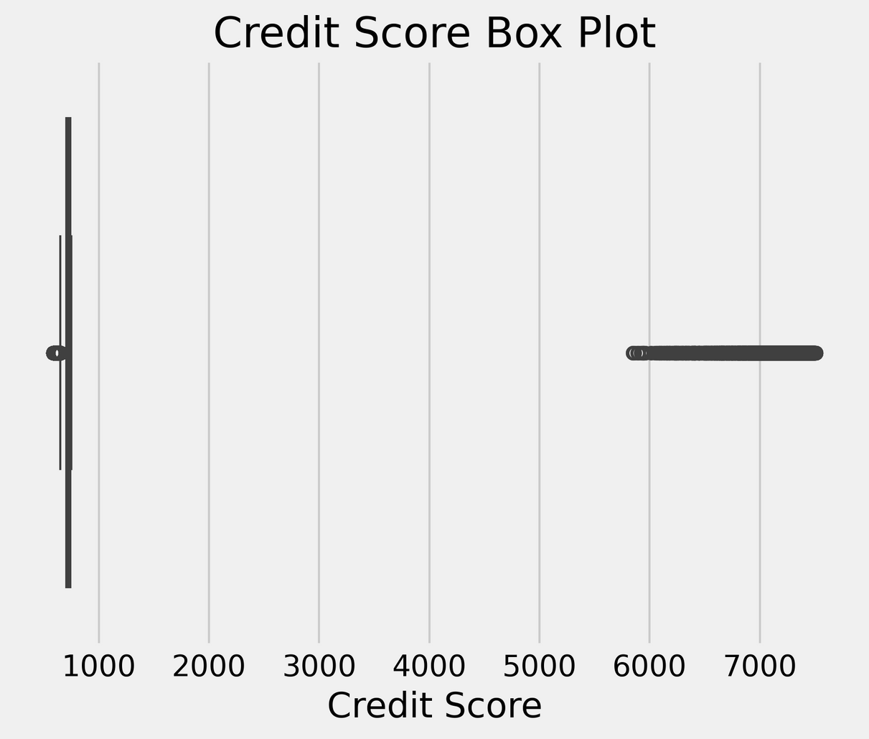
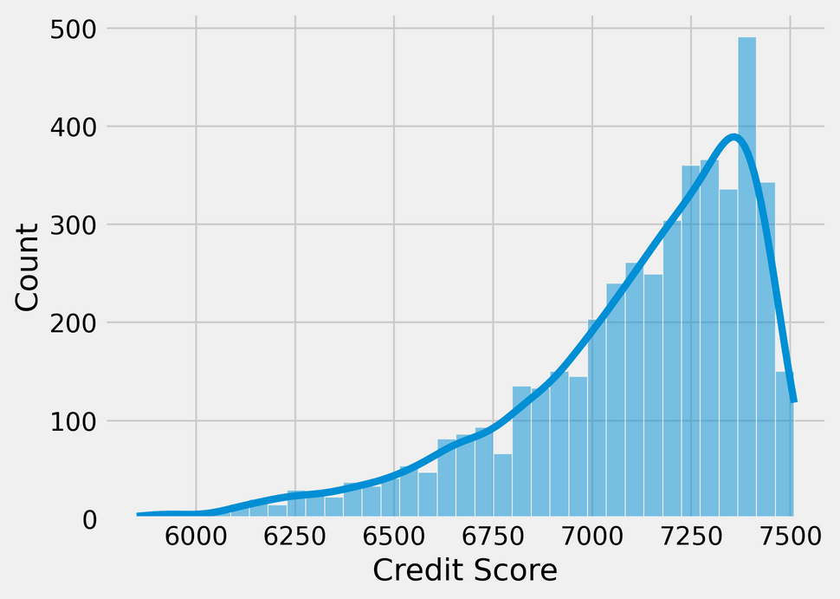
HANDLING OUTLIERS : CREDIT SCORE
Credit score values are usually between 300-900.
Problem: ‘Credit Score’ column in the dataset has some values multiplied by a factor of 10, which gives unnecessary outliers.
Solution: we divide the large values by 10 to bring the values within required range .
This plot includes count of credit scores greater than 1000

Slide 28
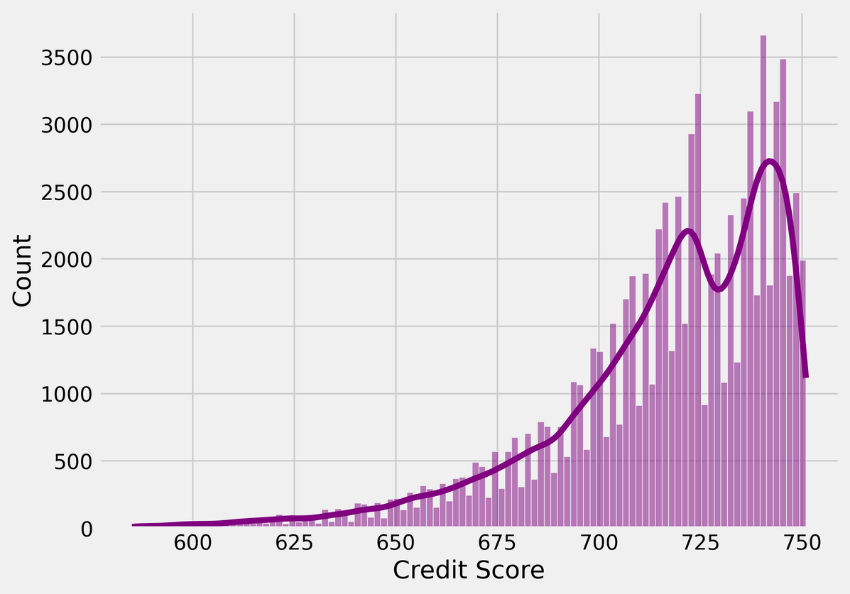
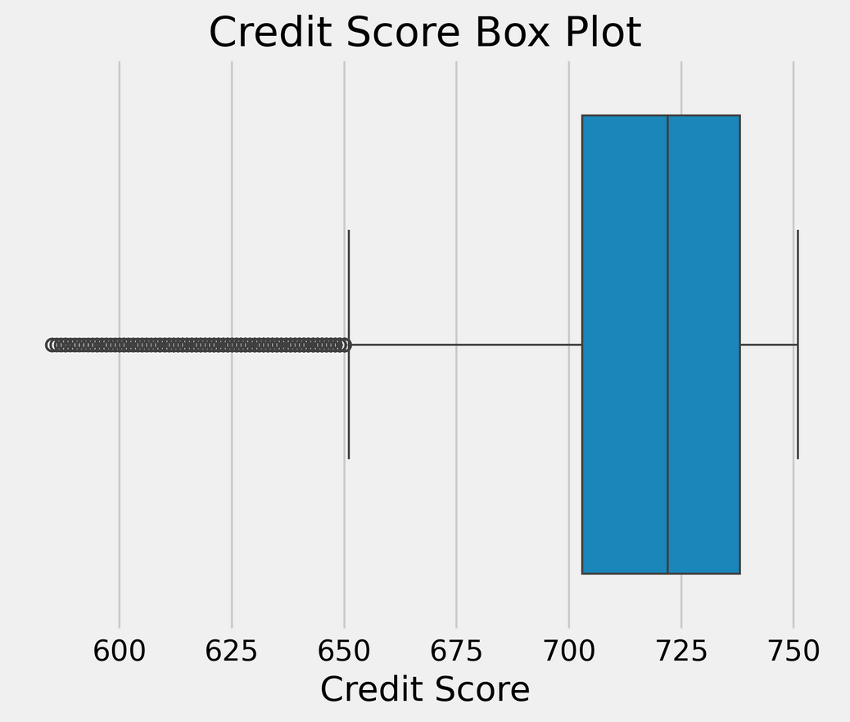
HANDLING OUTLIERS : CREDIT SCORE
Post Handling Outliers
Values are within desired limits

Slide 29
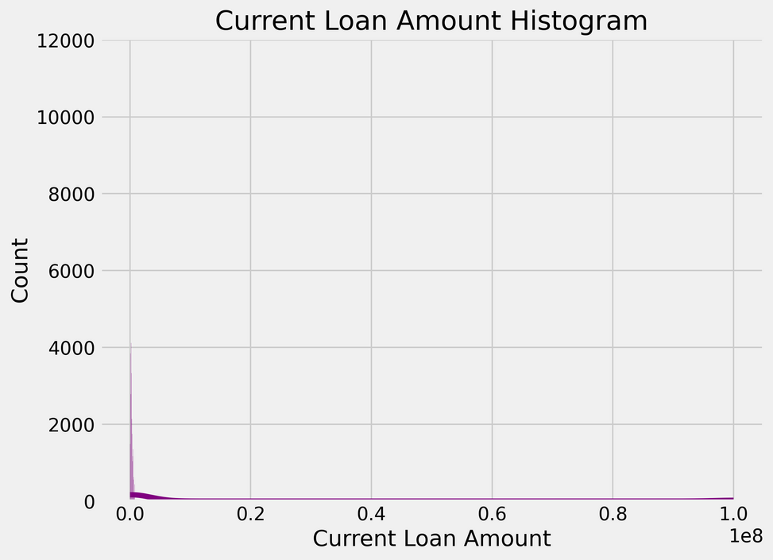
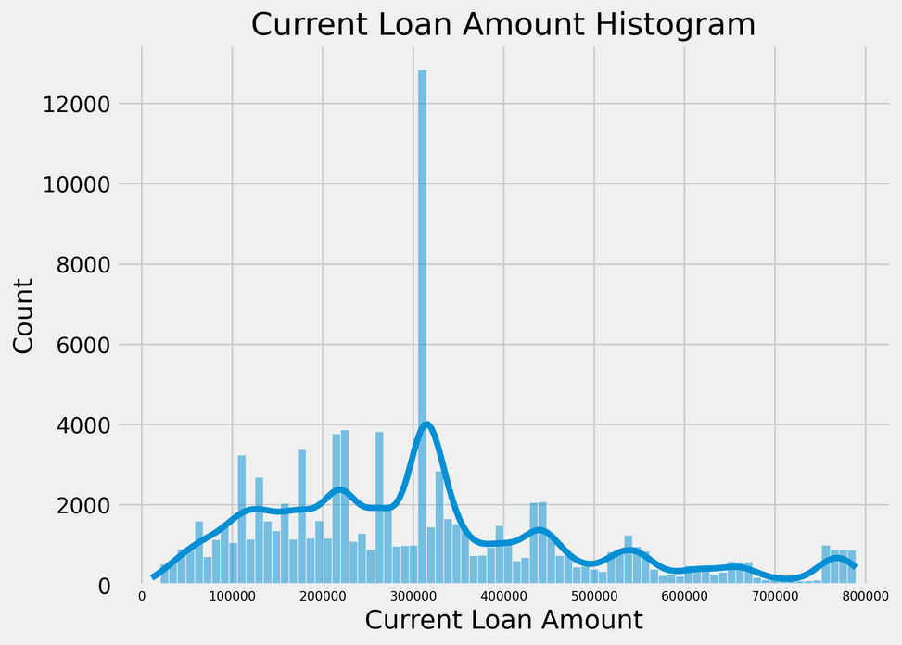
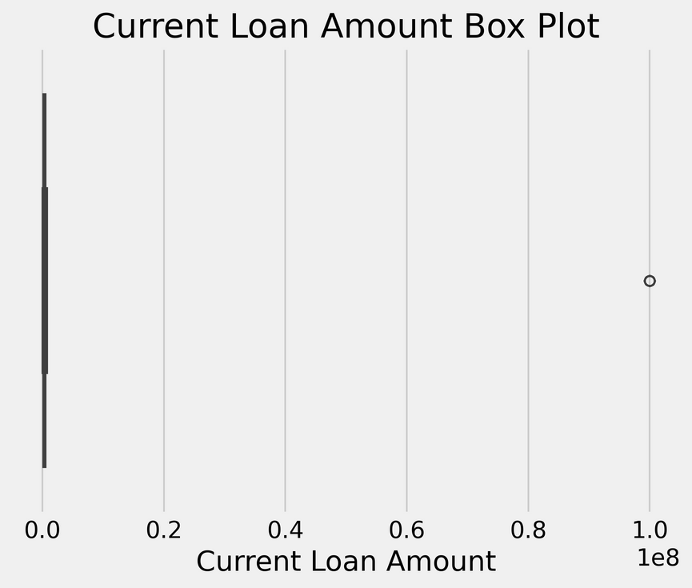
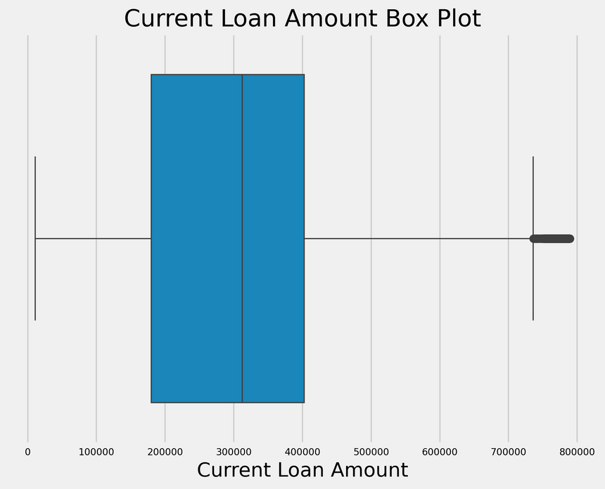
HANDLING OUTLIERS : CURRENT LOAN AMOUNT
Before
Problem: Arbitrary value for ‘Current Loan Amount’ after the maximum of it’s box plot.
Solution: Replace this value (99999999) by the mean of the remaining data.
After

Slide 30
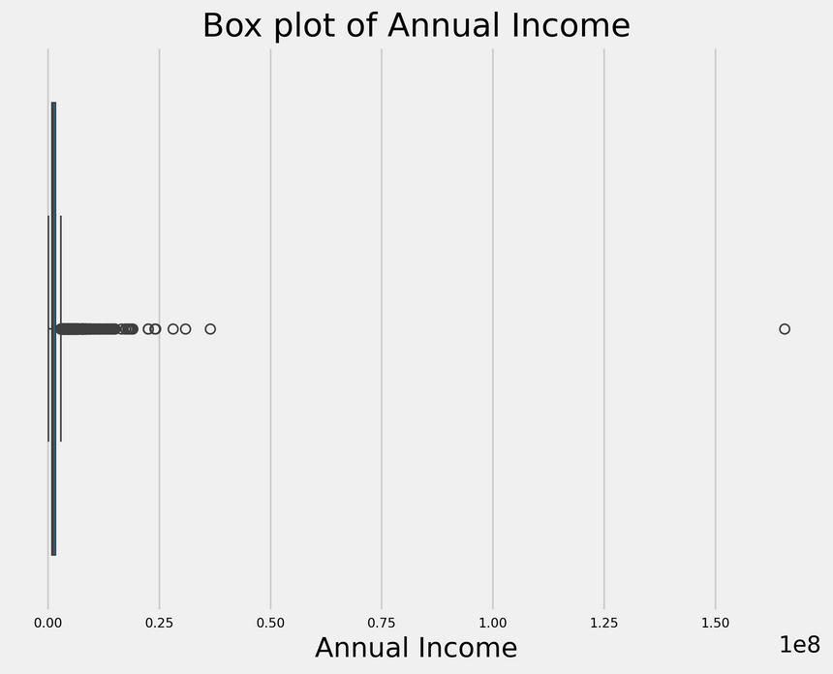
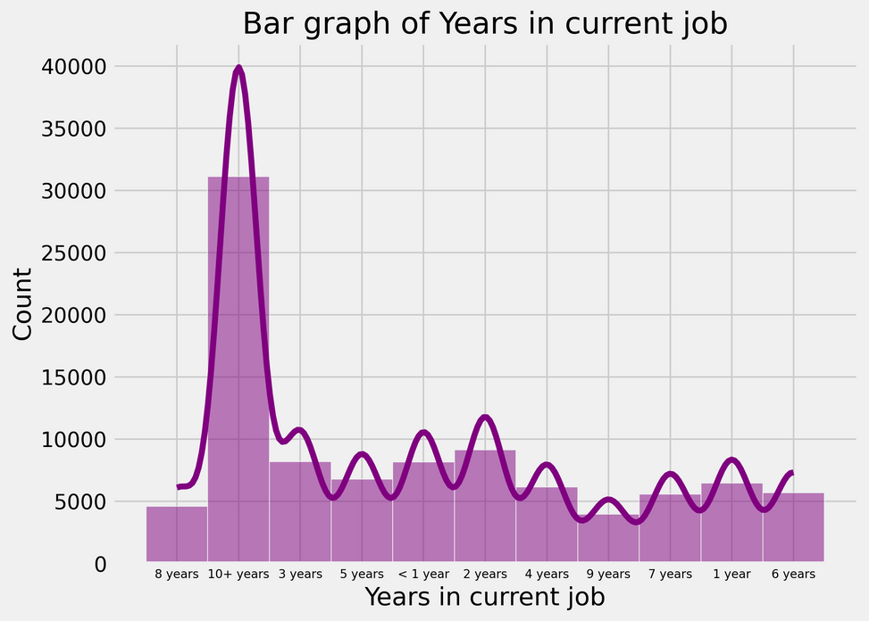
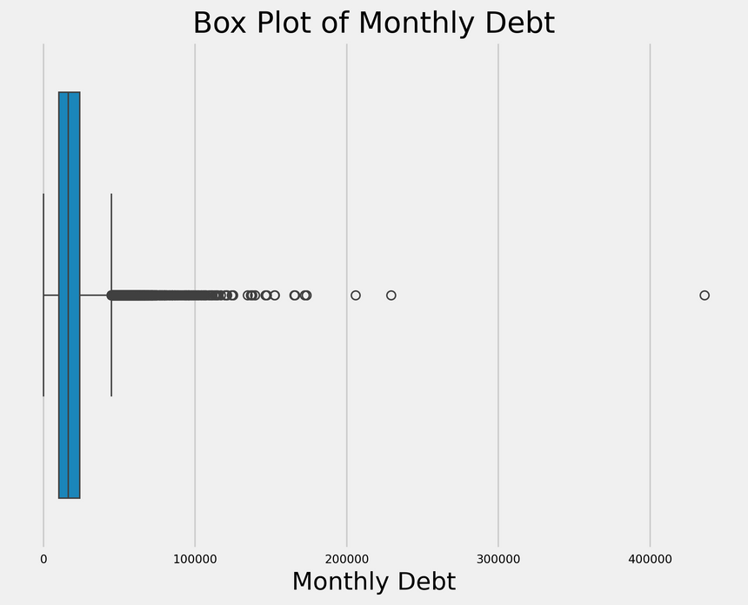
HANDLING OUTLIERS
Annual Income
Years in current job
Monthly Debt
The values above the maximum of the box plot are reasonable. Maximum value reaches 16,55,57,393.0 which is possible. So, not removing the outliers.
Reasonable values, considering corresponding income levels. So, no changes.
Reasonable values, no outliers observed

Slide 31
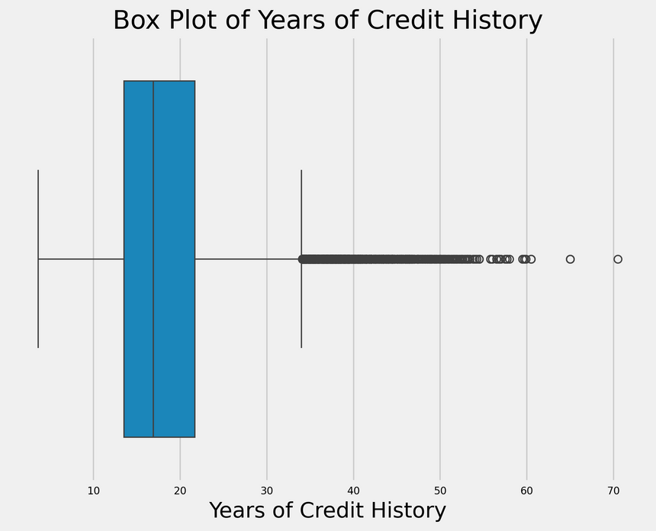
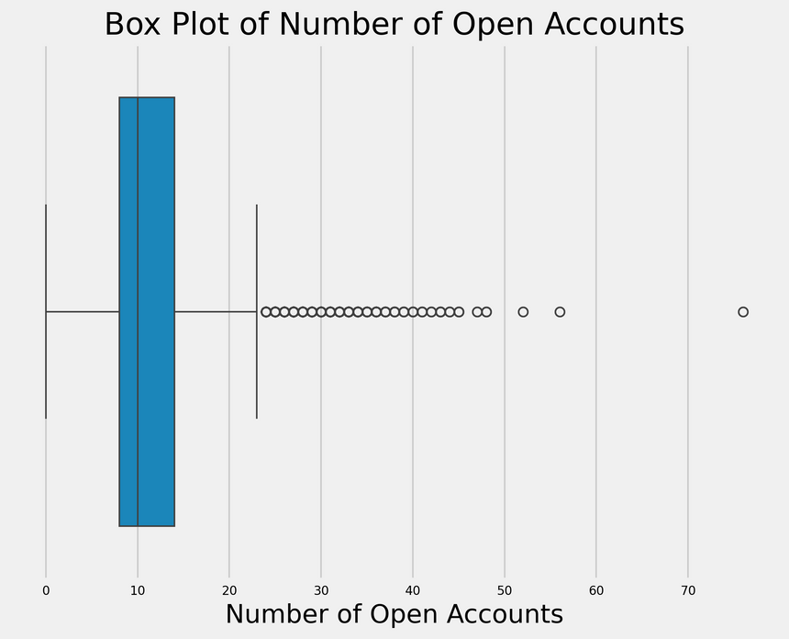
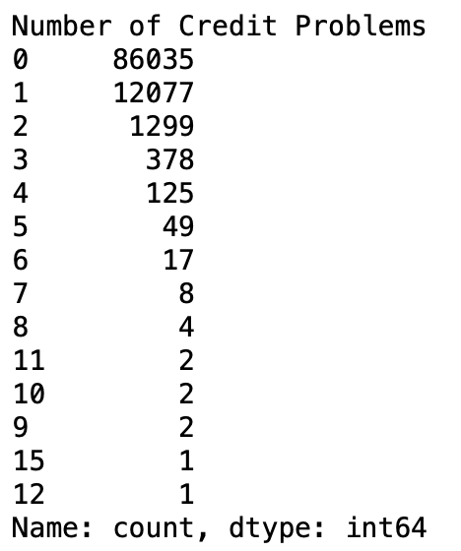
HANDLING OUTLIERS
Years of Credit History
Number of Open Accounts
Number of Credit Problems
Value Counts
There are some unusually high number of open accounts, so we put all the outliers on the box-plot on the maximum data value of the box-plot.
Reasonable values and these numbers could help in classifying correctly so, no changes.
Moving outliers to the maximum of the box plot.

Slide 32
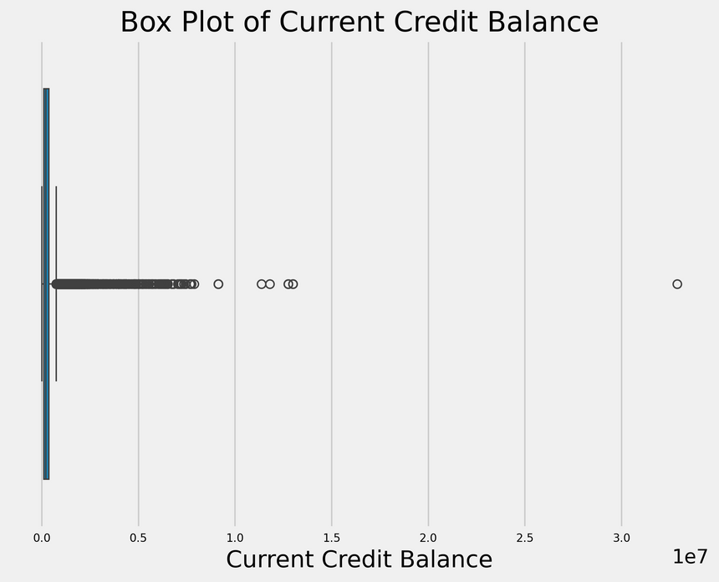
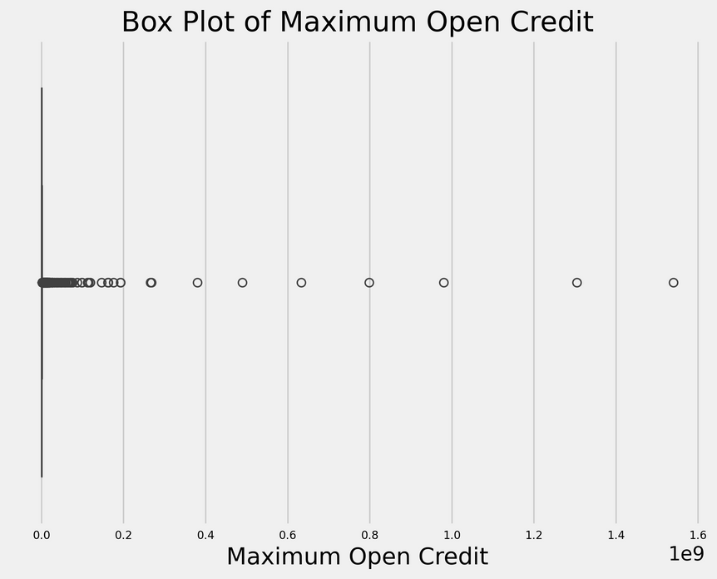
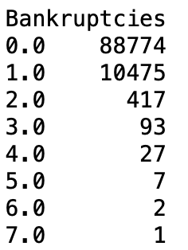
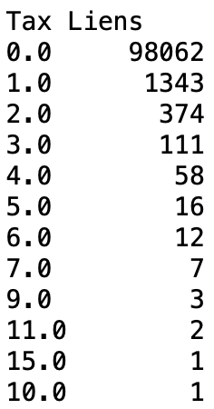
HANDLING OUTLIERS
Current Credit Balance
Maximum Open Credit
Bankruptcies & Tax Liens
Value Counts
Moving outliers to the maximum of box plot
Moving outliers to the maximum of box plot
Reasonable values and these numbers could help in classifying correctly so, no changes.

Slide 33
FEATURE
ENGINEERING

Slide 34
FEATURE SELECTION
As there is a high correlation between Bankruptcies and Number of Credit Problems we can remove one of the columns.

Slide 35
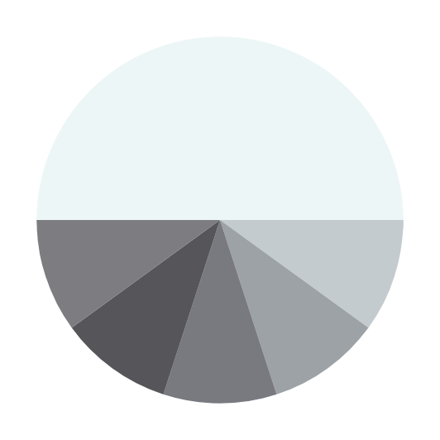
Feature
Creation
Credit Score Category
Debt-to-Income Ratio
Credit Utilization Ratio
Total Delinquencies
Rent and Mortgage
Create categories for continuous values
Ratio of monthly debt and monthly income
Ratio of current credit balance and maximum open credit
= Bankruptcies + Tax Liens
Transform home ownership column into two new columns
Could provide a sense of overall financial delinquency
Measures ability of the borrower to make monthly repayments
Indicates the percentage of available credit that you are currently using
Instead of having 3 category labels, changing into two new columns with binary encoders is better

Slide 36
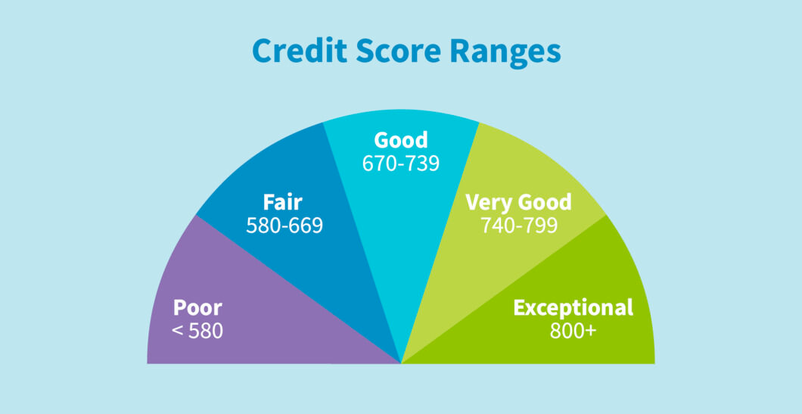
FEATURE CREATION : CREDIT SCORE
Changed continuous values to categories for credit score feature

Slide 37
FEATURE CREATION : RENT AND MORTGAGE
Original ‘Home Mortgage’ column has 3 labels: ‘Mortgage’, ‘Rent’ and ‘Own Home’
We change into two new columns with binary encoding (easy to encode),
Rent
Mortgage
Because everyone lives in a house and
Rent | Mortgage | Equivalent to
0 | 0 | Owning home
1 | 0 | Living in rented house
0 | 1 | Living in mortgaged house

Slide 38
MODEL SELECTION

Slide 39
Input Features
(X)
Target Variable (Y)
Numerical
Categorical
Categorical
Current Loan Amount
Credit Score
Annual Income
Years in current job
Monthly Debt
Years of credit history
Current Credit Balance
Number of Open Accounts
Number of Credit Problems
Maximum Open Credit
Bankruptcies
Tax Liens
Debt to income ratio
Total Delinquencies
Credit Utilization Ratio
Term
Purpose
Credit Score Category
Rent
Mortgage
Loan Status

Slide 40
MODELS
It is a classification problem so we will do initial runs on the following classficiation models and fine tune the 2 best ones:
Logistic Regression | KNN | XGBoost
Decision Tree | Random Forest
It is an imbalanced dataset problem, so, we will have to include resampling techniques if the performance is not as expected

Slide 41
START
Clean Dataset
Split
Train
Data
Validation Data
MODEL TRAINING FLOW
Encoding and Standardization of Training Data
Encoded and Standardized Validation data
Transformation
Train Models
Assess model performance and choose best two
Fine Tune Models
FINAL MODELS

Slide 42
MODEL TRAINING
AND EVALUATION

Slide 43
MODEL TRAINING
Initially, we ran the models with default values, here are the results:
 | Accuracy | Precision | Recall | F1 Score
Logistic Regression | 0.775 | 0.668 | 0.002 | 0.004
KNN | 0.742 | 0.335 | 0.146 | 0.203
Decision Trees | 0.709 | 0.354 | 0.334 | 0.345
Random Forest | 0.778 | 0.560 | 0.061 | 006
XGBoost | 0.773 | 0.481 | 0.089 | 0.151
Accuracy is not a good measure here as it is imbalanced class, and precision/recall scores are not good either, so use class weights parameter to train again.

Slide 44
Class weights modify the cost function by assigning higher importance to the minority class .
Thus, retraining the models with class weights give following results:
 | Accuracy | Precision | Recall | F1 Score
Logistic Regression | 0.577 | 0.289 | 0.602 | 0.391
KNN | 0.742 | 0.335 | 0.146 | 0.203
Decision Trees | 0.716 | 0.352 | 0.319 | 0.337
Random Forest | 0.776 | 0.546 | 0.041 | 0.004
XGBoost | 0.635 | 0.332 | 0.613 | 0.431
We see that the model performs better here, as we have higher values for recall. We would prefer high recall values as we want to predict defaulters accurately.

Slide 45
So, we choose logistic regression and XGBoost Classifier models for fine tuning mainly because of the relatively high recall and decent accuracy(60%).
Logistic Regression
XGBoost Classifier
{
'n_estimators': [50, 100, 150],
'max_depth': [None],
'learning_rate': [0.1, 0.01, 0.001],
'scale_pos_weight': [negative_class_count / positive_class_count]
}
{
'penalty': ['l1', 'l2', 'elasticnet', None],
'max_iter': [50, 100, 150],
'class_weight': ['balanced']
}
Parameters:
Parameters:
We will maximise recall and analyse other metrics.
We will maximise recall and analyse other metrics.

Slide 46
We are maximising recall as tells what percentage of positive samples are correctly classified. Here positive samples means correctly identifying defaulters.
Logistic Regression
XGBoost Classifier
{'learning_rate': 0.01, 'max_depth': None, 'n_estimators': 50, 'scale_pos_weight': 3.4127238558478887}
Best
Parameters:
{'class_weight': 'balanced', 'max_iter': 50, 'penalty': 'l2'}
Best
Parameters:
Scores on validation set
Scores on validation set
Accuracy: 0.57
Precision:0.29
Recall:0.61
F1-Score: 0.4
ROC_AUC_SCORE: 0.625
Accuracy: 0.57
Precision:0.30
Recall:0.70
F1-Score: 0.42
ROC_AUC_SCORE: 0.68

Slide 47
CONCLUSIONS
The data is imbalanced and thus we needed other scoring metrics to analyse the model. Recall was the main metric used here.
Our fine tuned models are not completely robust as they still have low precision and low accuracy considering the industry requirements.
The model has low precision which means, there maybe customers we falsely detect as defaulters, so it could impact customer retention.
Different resampling methods like SMOTE, ADASYN etc. were tried but more research and reading is needed to implement them correctly for fruitful results. (The methods tried can be found in the Jupyter Notebook shared)

Slide 48
CONCLUSIONS
What could be done to improve the model:
Get more data, make it balanced
Train more different models, use more robust techniques of outlier handling, feature selection etc. (Basically, research more, train more)
Apply resampling techniques, there are many different types and could be used in case of imbalanced dataset to generate synthetic samples.

Slide 49
REFERENCES
M. A. Sheikh, A. K. Goel and T. Kumar, "An Approach for Prediction of Loan Approval using Machine Learning Algorithm," 2020 International Conference on Electronics and Sustainable Communication Systems (ICESC), Coimbatore, India, 2020, pp. 490-494, doi: 10.1109/ICESC48915.2020.9155614.
Kotsiantis, Sotiris & Kanellopoulos, D. & Pintelas, P.. (2005). Handling imbalanced datasets: A review. GESTS International Transactions on Computer Science and Engineering. 30. 25-36.

